Slide 1


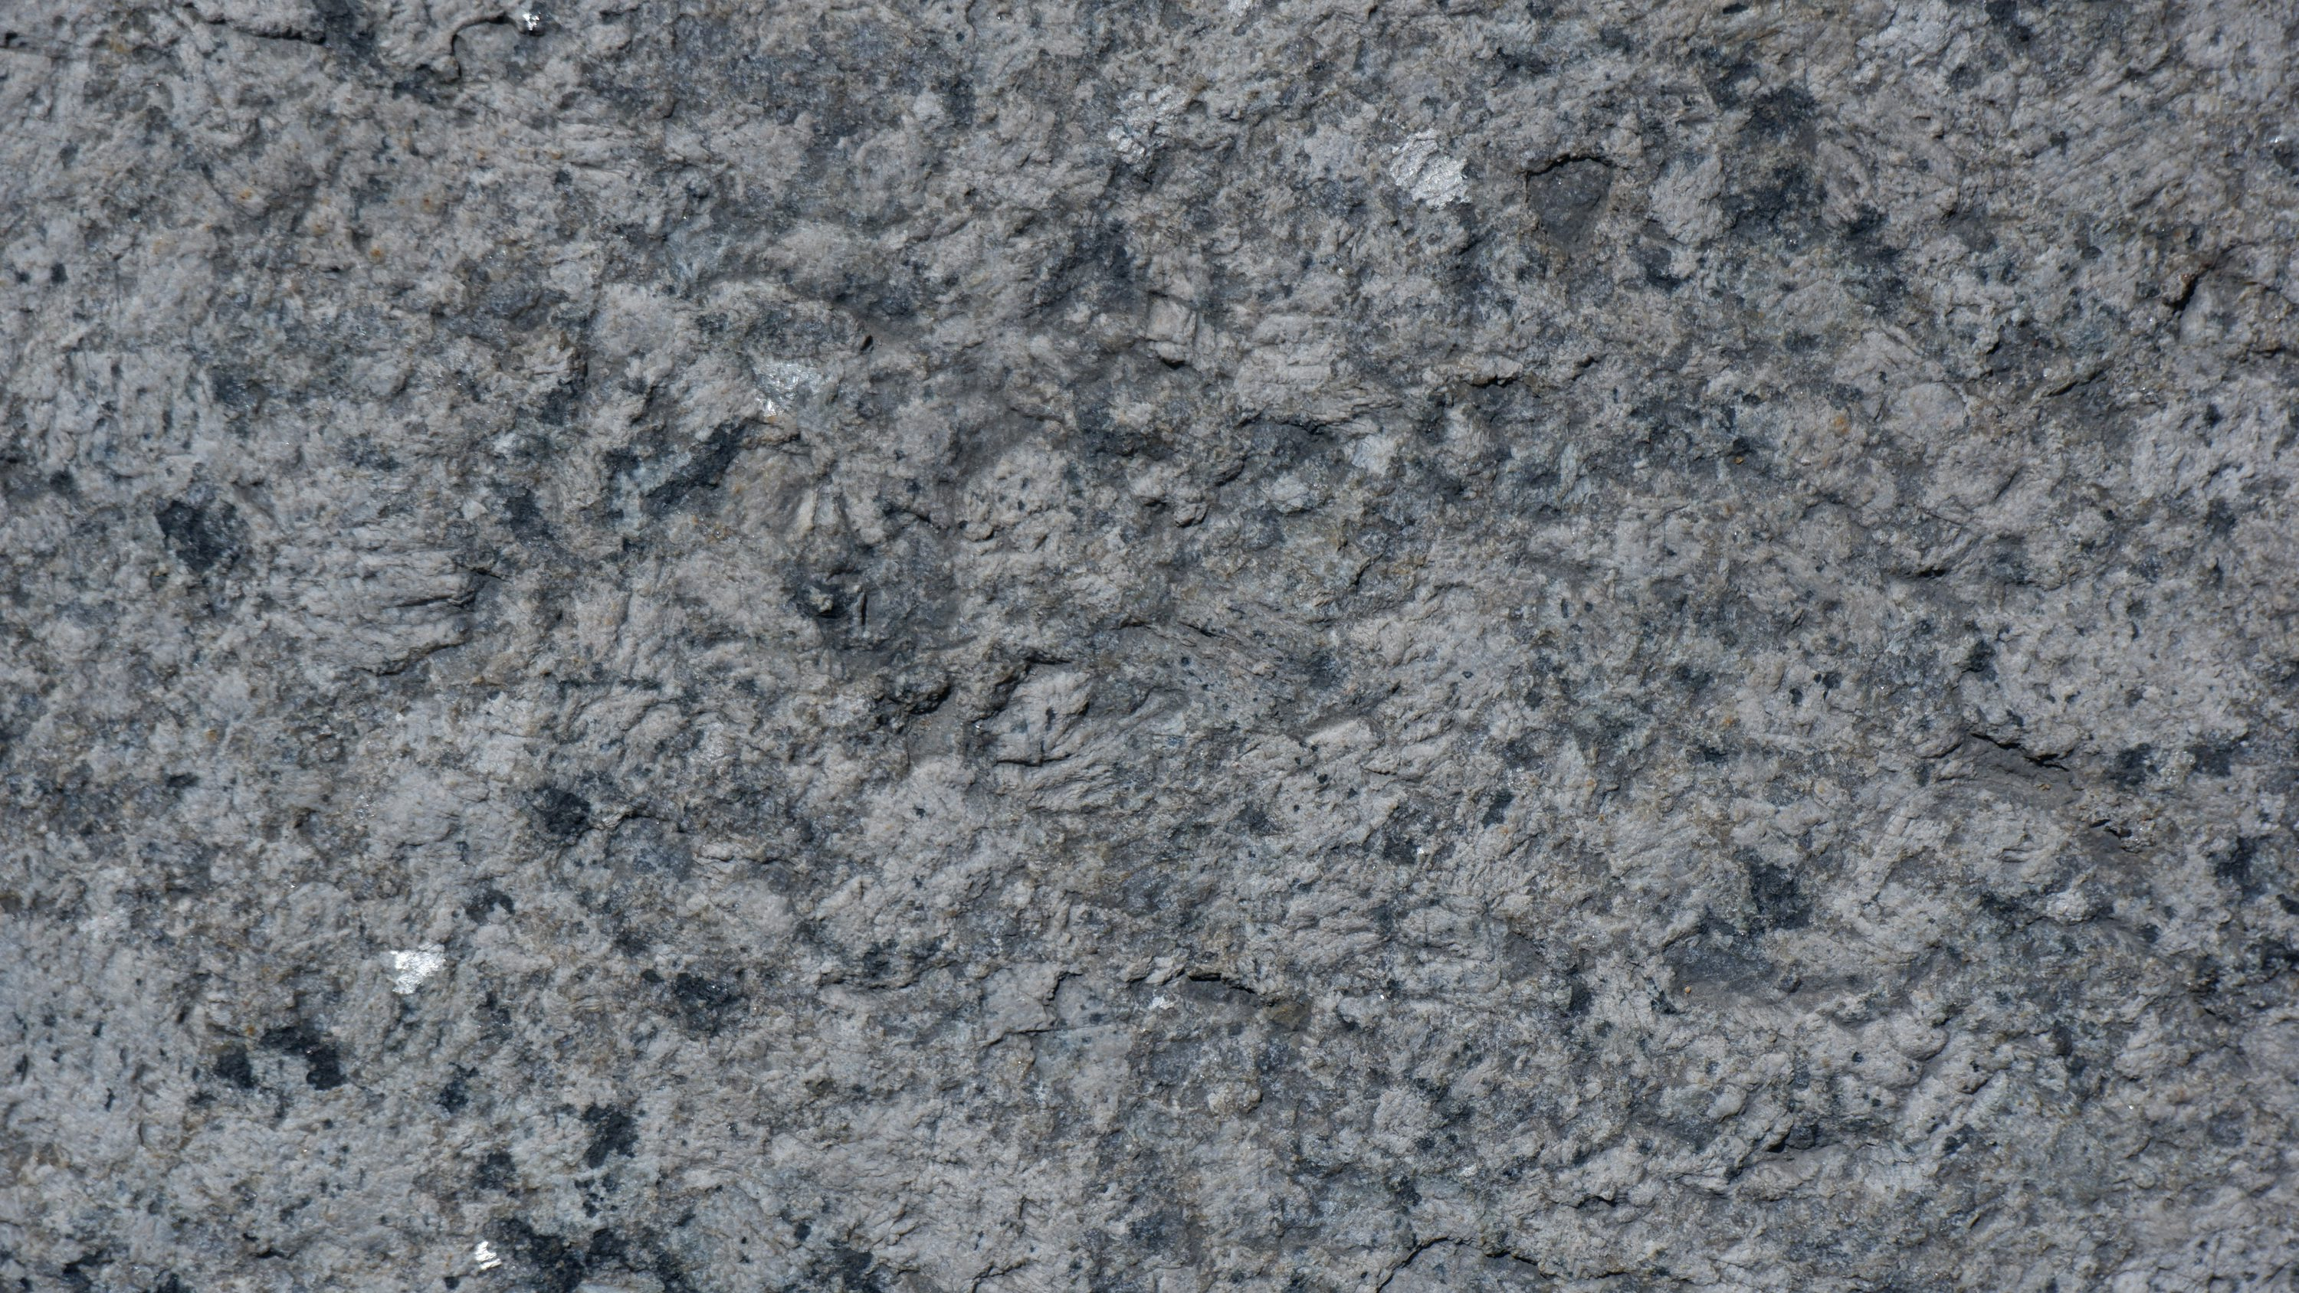
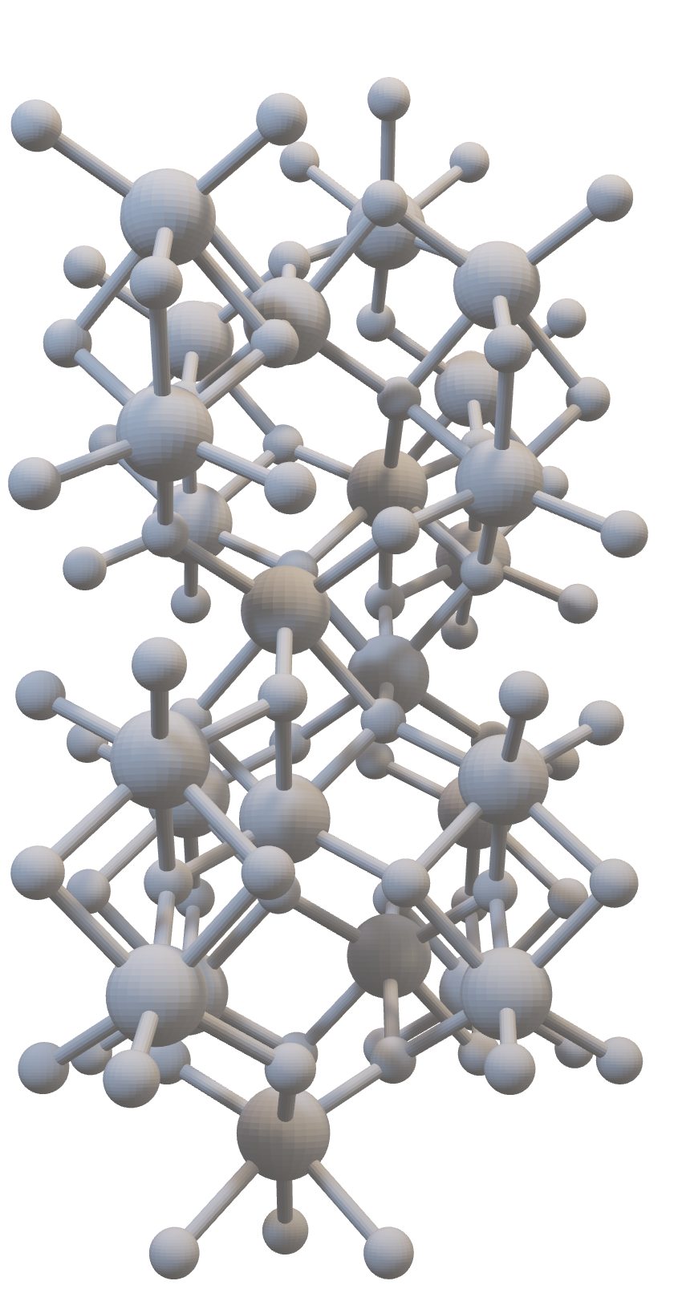
Crystal
Classification
CSCI2291 SPRING 2025 FINAL PROJECT
Myles Grant Jaden Park
2
Methodology
Materials Project
Features
Preprocessing
Exploratory Data Analysis
Models
1
Motive/Goal
Materials Prediction
Properties
Crystal Lattice
3
Results
Linear
Linear with ENR
Polynomial with ENR
XGBRegressor Model

Slide 2

Crystal
Classification
CSCI2291 SPRING 2025 FINAL PROJECT
Myles Grant Jaden Park
1
2
3
Motive/Goal
Materials Prediction
Properties
Crystal Lattice
Methodology
Materials Project
Features
Preprocessing
Exploratory Data Analysis
Models
Results
Linear
Linear with ENR
Polynomial with ENR
XGBRegressor Model

Slide 3
Goal
Predict crystal structure from properties of material
Materials are fundamental to everything: infrastructure, energy, computation, medicine, research, general quality of life
There are about 300k known materials today both natural and man made
Searching and also finding new materials are paramount to engineering new solutions in all facets of life

Slide 4
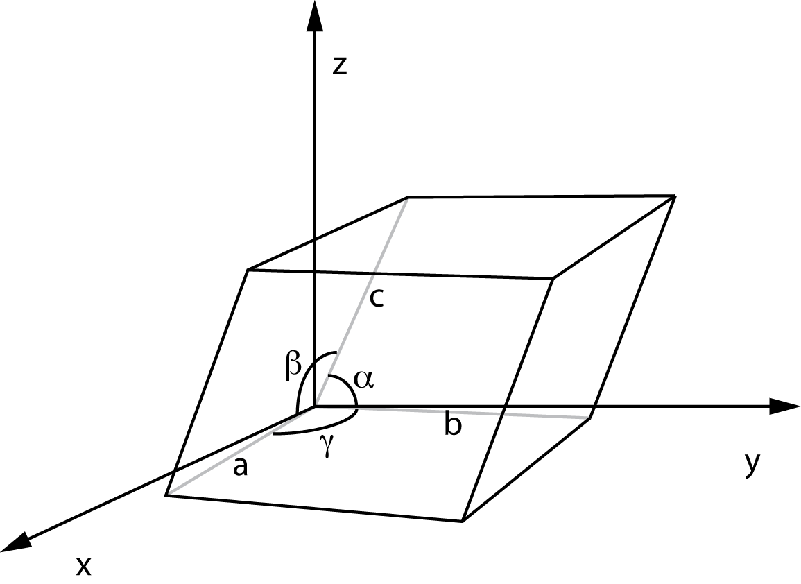
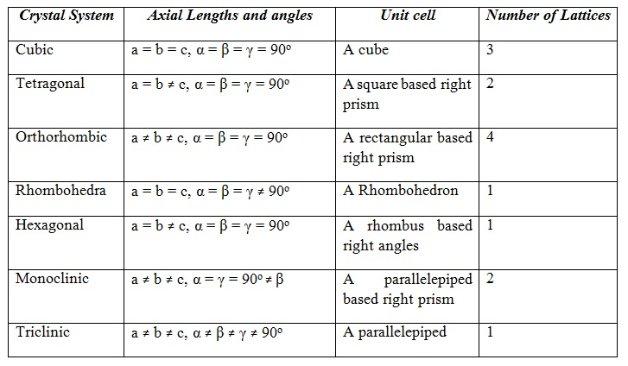
Crystals
The solid state of materials is one we interact the most with, and can be split into two categories: amorphous and crystalline
crystals are defined as a solid material with a repeating structure.
This means that we can define a unit cell (like a lego block) with side length and angles that remain constant and can describe the whole structure with only the translation operation

Slide 5
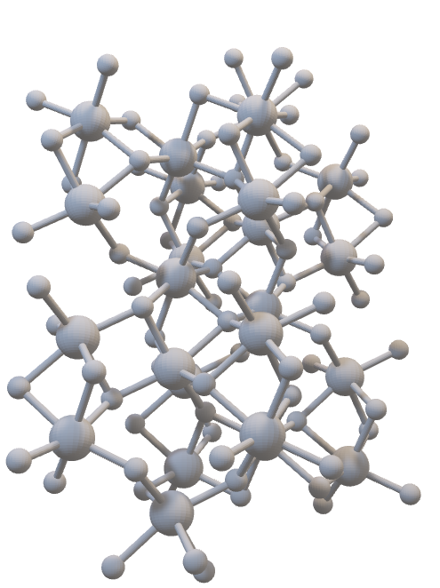
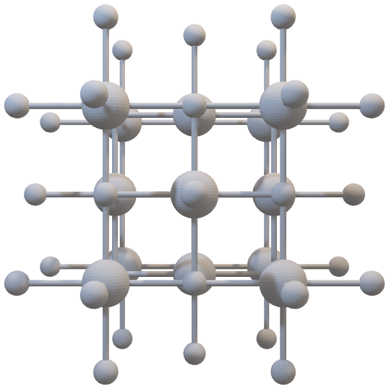
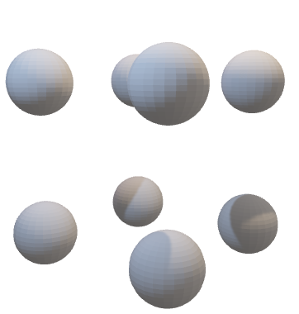

Slide 6
Properties and can we use data science to predict possible lattice constants for desired properties

Slide 7
Database
Materials Project Database
material_id
formula_pretty
elements
nelements
band_gap
density
formation_energy_per_atom
energy_above_hull
bulk_modulus
shear_modulus
volume
nsites
total_magnetization
structure
Unique id of the material
Chemical formula
Elements in the crystal
Number of elements
Band gap – conductivity of material
Mass Density
Formation energy – energy released/absorbed during formation
Lowest energy above convex hull (stability of material)
Bulk modulus – resistivity to stress
Shear modulus – resistivity to shear
Volume
Nsites -
Total magnetization
Lattice constants

Slide 8
Preprocessing, EDA

Slide 9
Modeling
Choose modeling technique
Linear Model
Linear Model with Elastic Net Regression
Polynomial Model with Elastic Net Regression
XGBRegressor Model (Chosen)
Regularization
Elastic Net Regularization
Mix of L1 and L2 regularization
Define performance metrics
Mean Squared Error (MSE):
Penalizes large errors heavily (good for scientific prediction tasks).
Appropriate because lattice parameter errors accumulate nonlinearly.
Tune hyperparameters
Play around with different values for the Polynomial Degree, Regularization Strength (alpha for Ridge/Lasso/Elastic Net), and Elastic Net mixing ratio (l1_ratio).

Slide 10
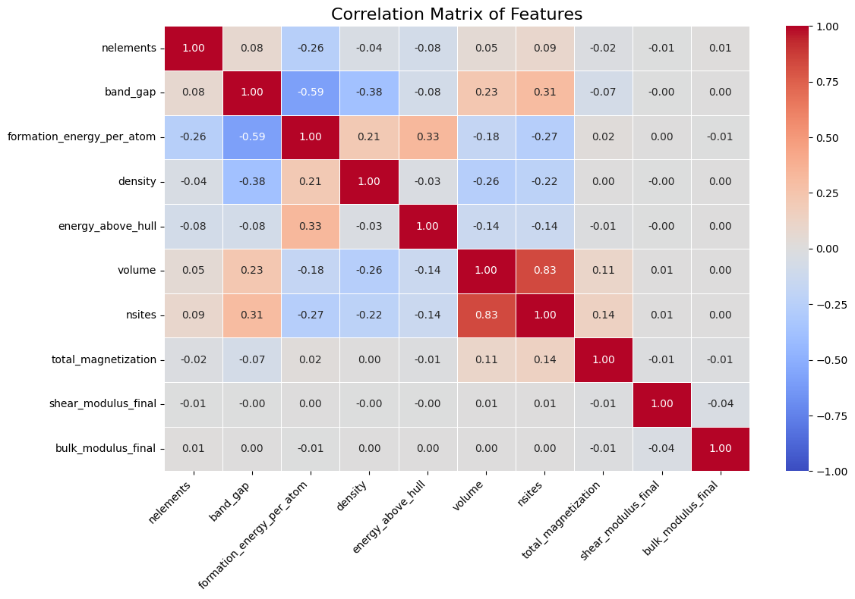
There was only a significant correlation between volume and nsites (above 0.7 or below -0.7), so overall there was not a high degree of multicollinearity present, meaning that dimensionality reduction via PCA was not strictly necessary for removing redundancy, but could still be useful for noise reduction or visualization.

Slide 11
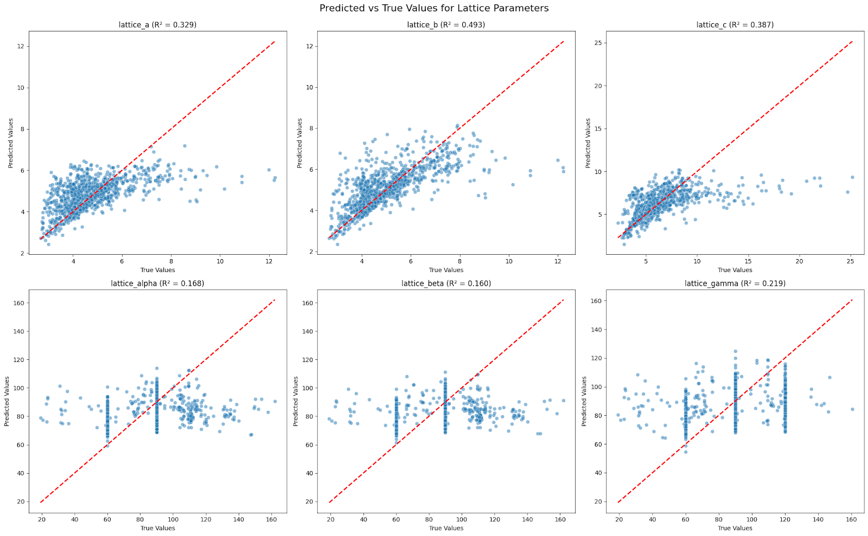
Linear Model
Metrics
Linear Regression Model Performance:
R² = 0.293
MSE = 197.864
Performance Metrics per Output:
lattice_a:
R² = 0.329
MSE = 0.973
lattice_b:
R² = 0.493
MSE = 0.835
lattice_c:
R² = 0.387
MSE = 3.958
lattice_alpha:
R² = 0.168
MSE = 361.373
lattice_beta:
R² = 0.160
MSE = 355.277
lattice_gamma:
R² = 0.219
MSE = 464.768

Slide 12
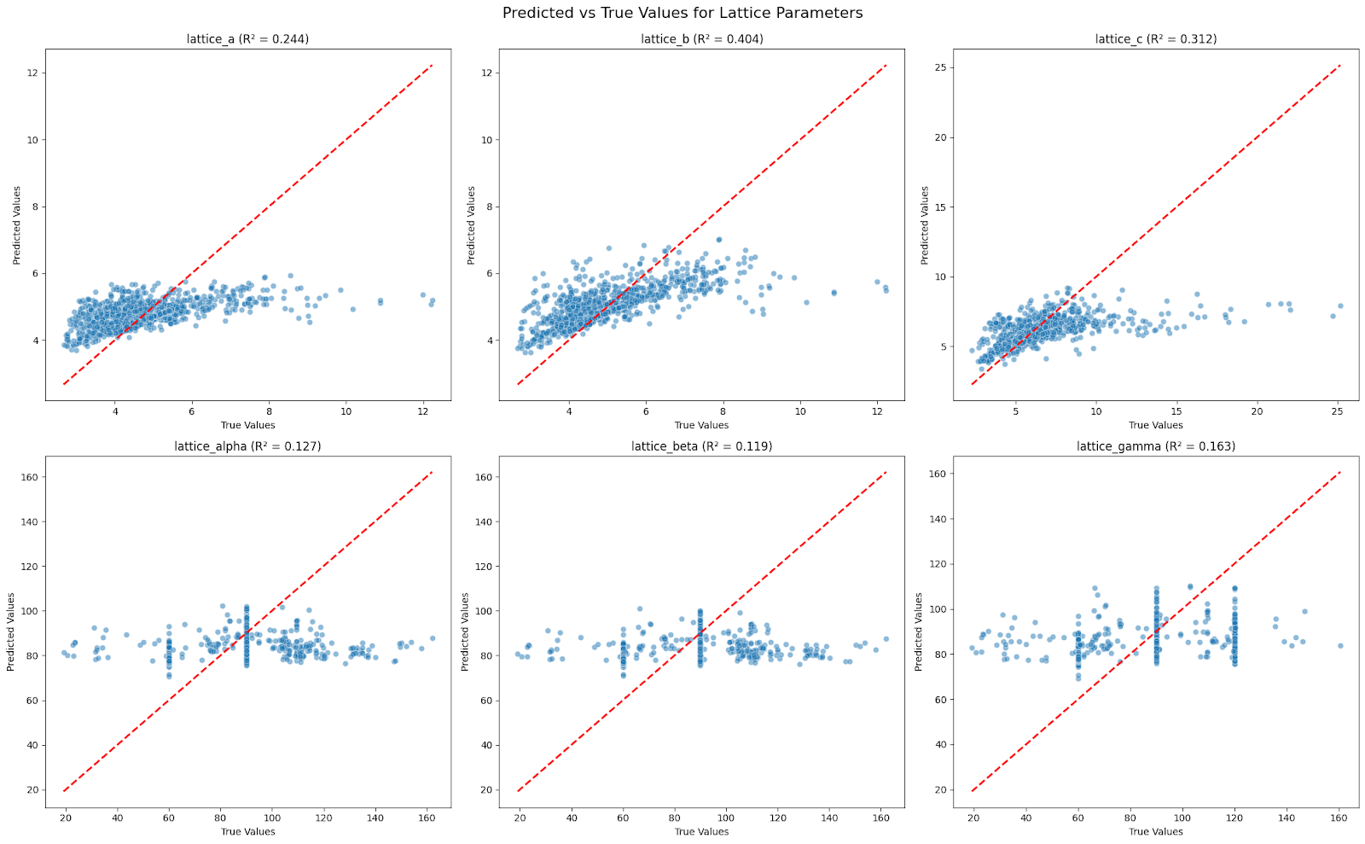
Linear Model with Elastic Net Regularization
Metrics
Optimized ElasticNet Model Performance:
R² = 0.228
MSE = 209.458
Performance Metrics per Output:
lattice_a:
R² = 0.244
MSE = 1.096
lattice_b:
R² = 0.404
MSE = 0.981
lattice_c:
R² = 0.312
MSE = 4.442
lattice_alpha:
R² = 0.127
MSE = 379.299
lattice_beta:
R² = 0.119
MSE = 372.869
lattice_gamma:
R² = 0.163
MSE = 498.064

Slide 13
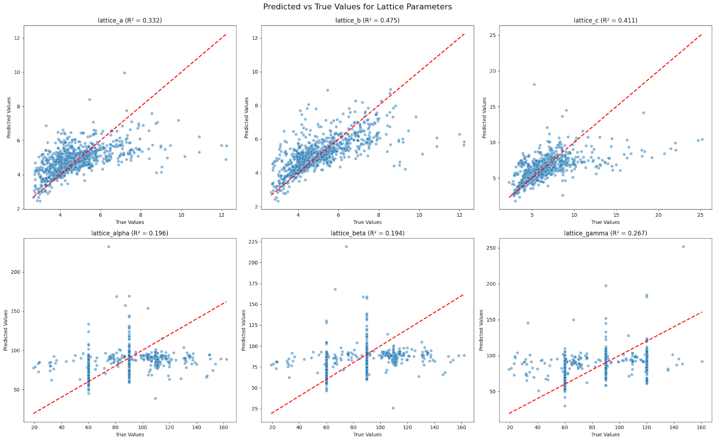
Polynomial Model with Elastic Net Regularization
Metrics
Optimized Polynomial Regression Model Performance:
R² = 0.312
MSE = 188.704
Performance Metrics per Output:
lattice_a:
R² = 0.332
MSE = 0.968
lattice_b:
R² = 0.475
MSE = 0.865
lattice_c:
R² = 0.411
MSE = 3.802
lattice_alpha:
R² = 0.196
MSE = 349.356
lattice_beta:
R² = 0.194
MSE = 340.983
lattice_gamma:
R² = 0.267
MSE = 436.249

Slide 14
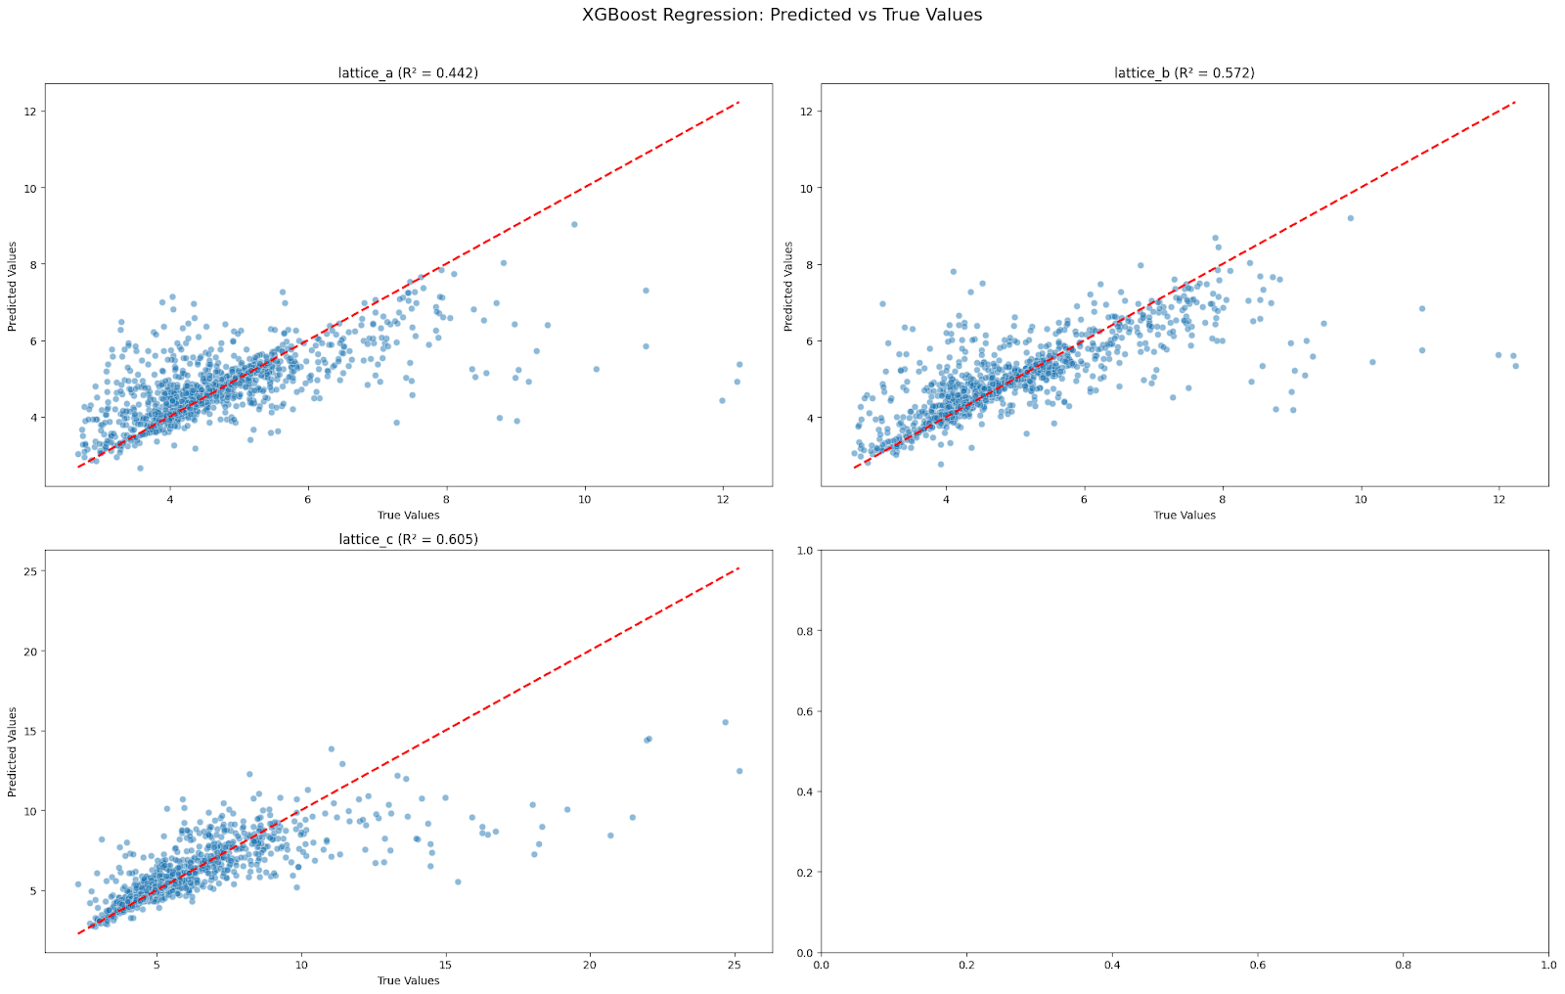
XGBRegressor Model
Metrics
Training model for: lattice_a
Fitting 5 folds for each of 50 candidates, totalling 250 fits
Best Params = {'subsample': 1.0, 'reg_lambda': 0.1, 'reg_alpha': 1, 'n_estimators': 300, 'max_depth': 10, 'learning_rate': 0.05, 'colsample_bytree': 0.6}
Mean R² = 0.461
Training model for: lattice_b
Fitting 5 folds for each of 50 candidates, totalling 250 fits
Best Params = {'subsample': 1.0, 'reg_lambda': 1, 'reg_alpha': 1, 'n_estimators': 300, 'max_depth': 15, 'learning_rate': 0.05, 'colsample_bytree': 0.6}
Mean R² = 0.590
Training model for: lattice_c
Fitting 5 folds for each of 50 candidates, totalling 250 fits
Best Params = {'subsample': 0.8, 'reg_lambda': 5, 'reg_alpha': 0, 'n_estimators': 500, 'max_depth': 10, 'learning_rate': 0.05, 'colsample_bytree': 0.6}
Mean R² = 0.555
Training model for: lattice_alpha
Fitting 5 folds for each of 50 candidates, totalling 250 fits
Best Params = {'subsample': 0.8, 'reg_lambda': 0.1, 'reg_alpha': 0.1, 'n_estimators': 700, 'max_depth': 15, 'learning_rate': 0.1, 'colsample_bytree': 1.0}
Mean F1 = 0.802
Training model for: lattice_beta
Fitting 5 folds for each of 50 candidates, totalling 250 fits
Best Params = {'subsample': 1.0, 'reg_lambda': 5, 'reg_alpha': 0, 'n_estimators': 700, 'max_depth': 10, 'learning_rate': 0.2, 'colsample_bytree': 0.8}
Mean F1 = 0.810
Training model for: lattice_gamma
Fitting 5 folds for each of 50 candidates, totalling 250 fits
Best Params = {'subsample': 1.0, 'reg_lambda': 5, 'reg_alpha': 0.1, 'n_estimators': 700, 'max_depth': 15, 'learning_rate': 0.2, 'colsample_bytree': 0.8}
Mean F1 = 0.704

Slide 16
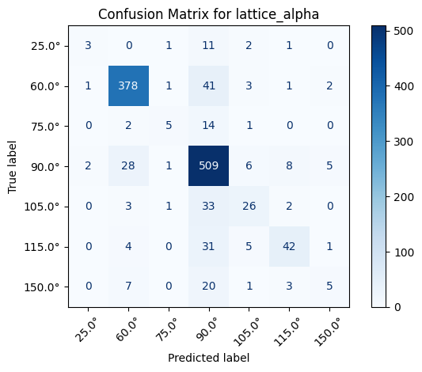

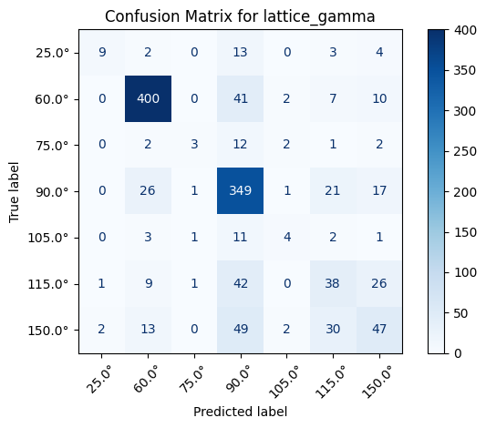
Interpretation
The XGBoost model developed for predicting lattice parameters and angles demonstrated solid overall performance, particularly in the classification tasks. For the regression targets—lattice_a, lattice_b, and lattice_c—the model achieved mean R² scores of 0.461, 0.590, and 0.555, respectively. These scores indicate that the model can explain approximately 46% to 59% of the variance in the respective target variables, reflecting a moderate level of predictive accuracy. In contrast, the classification tasks for lattice_alpha, lattice_beta, and lattice_gamma yielded stronger performance, with macro-averaged F1 scores of 0.800, 0.807, and 0.702, respectively, demonstrating effective generalization and balanced precision-recall tradeoffs across the angle bins.
The modeling approach employed several advanced techniques to optimize performance. XGBoost was used as the core algorithm for both regression and classification tasks due to its efficiency and strong performance in handling structured data. Hyperparameter optimization was carried out using RandomizedSearchCV with 5-fold cross-validation, allowing the model to explore a broad hyperparameter space in an efficient manner. Key hyperparameters tuned included the number of estimators, learning rate, maximum tree depth, subsample ratios, and column sampling rates, in addition to two regularization parameters: reg_alpha for L1 regularization and reg_lambda for L2 regularization.

